Slide 1
Stroke Analysis
A stroke is a medical condition in which poor blood flow to the brain causes cell death. It occurs when a blood vessel that carries oxygen and nutrients to the brain is either blocked by a clot or bursts or ruptures (Wikipedia).

Slide 2
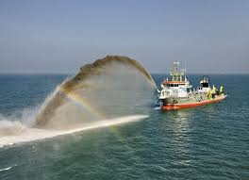
Data Dredgers
Ezra Mageto 4. Mary Mbugua
Vivian Katheu 5. Kelvin Njunge
Lawrence Ondieki - TL

Slide 3
Agenda
Context.
Problem Statement.
Objectives
Hypothesis.
Research Findings.
Conclusions.
Recommendations.

Slide 4
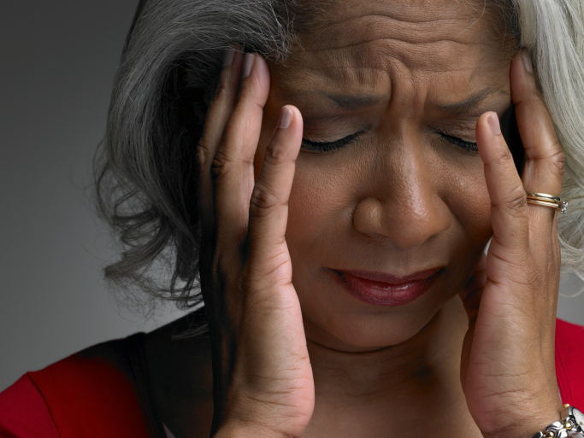
Signs of Stroke in Men and Women(CDC)
Sudden numbness or weakness in the face, arm, or leg, especially on one side of the body.
Sudden confusion, trouble speaking, or difficulty understanding speech.
Sudden trouble seeing in one or both eyes.
Sudden trouble walking, dizziness, loss of balance, or lack of coordination.
Sudden severe headache with no known cause.
Call for emergency help (911/112) right away if you or someone else has any of these symptoms.

Slide 5
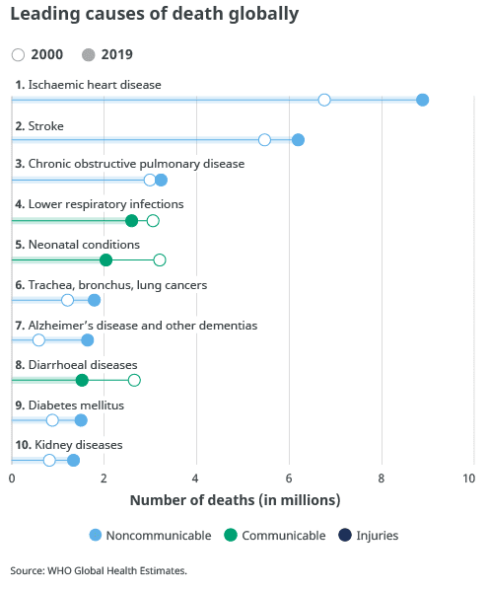
Context
Globally, 7 of the 10 leading causes of deaths in 2019 were noncommunicable diseases. These seven causes accounted for 44% of all deaths or 80% of the top 10. However, all noncommunicable diseases together accounted for 74% of deaths globally in 2019.
Stroke is the 2nd leading cause of death globally, responsible for approximately 11% of total deaths.

Slide 6
Problem Statement
According to World Health Organization (WHO), stroke is a number 2 leading cause of global deaths in 2019.
Stroke most of the time causes long term disability. This affects people severely, in terms of their productive life and as such, stroke poses a significant threat to global health.

Slide 7
General Objective
To analyze the factors that contribute to getting a stroke and the extent to which they increase or decrease the chances of getting a stroke.

Slide 8
Specific Objectives
Which gender is more prone to getting a stroke?
Is one likely to get a stroke based on their marital status?
Which age group
has the highest
risk of getting a stroke?
Does the body
mass index (BMI) level affect the chances of getting
a stroke?
Does smoking,
heart disease and hypertension cause a stroke?
Does the type of work affect your chances of getting a stroke?

Slide 9
Analysis Process
We used the following during the analysis process:-
Google Collab notebook.
Tableau Public for visualization.
Trello for project tracking.
Google Slides for presentation.
Google docs for data report.

Slide 10
Hypothesis
Null Hypothesis (Ho): Risk of getting a stroke is evenly distributed among all age groups.
Alternative Hypothesis (Ha): Individuals between the age of 75-79 have the highest risk of getting a stroke.

Slide 11
Research Findings

Slide 12
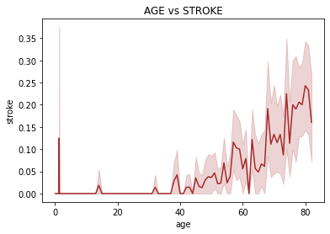
Bivariate Analysis - Age factor
When one reaches a particular age,roughly 50 and above chances of getting a stroke also increase.

Slide 13
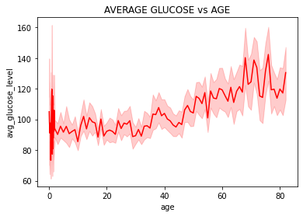
Bivariate Analysis- Average Glucose
As the age increases the glucose level also increases.
There is a positive correlation between the average glucose and age.

Slide 14
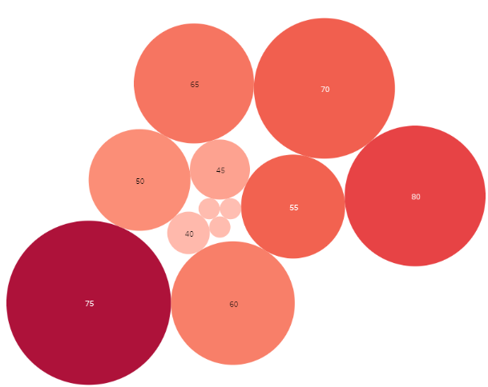
Individuals within the age bracket 75-79 have the highest risk of getting stroke.

Slide 15
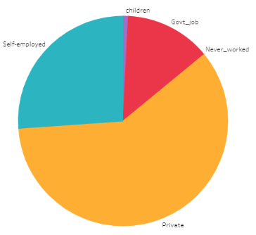
Individuals working in the private sector contribute the highest proportion of the people affected by stroke

Slide 16
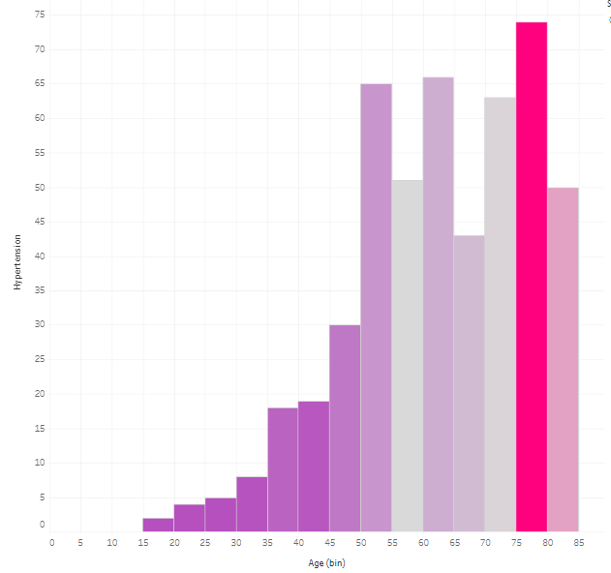
Hypertension is common in middle aged and old age

Slide 17
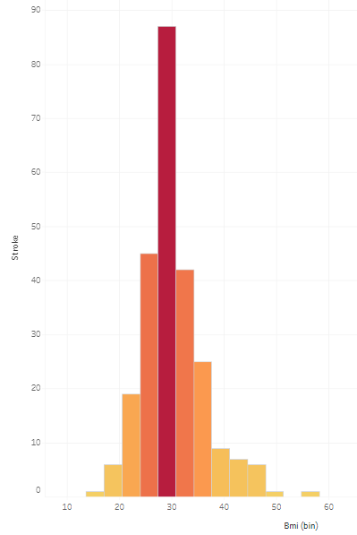

Degree of obesity, defined by BMI is a significant risk factor

Slide 18
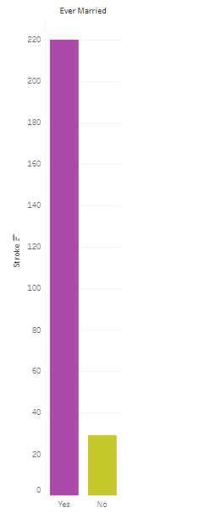

Unhappily married or divorced individuals have a very high risk of getting stroke

Slide 19
Conclusions
Null Hypothesis (Ho): Risk of getting a stroke is evenly distributed among all age groups.
From the study, risk of getting stroke is not evenly distributed among all age groups.
individuals between the age of 75-79 have the highest risk of getting a stroke. Therefore, we reject the null hypothesis.

Slide 20
Recommendations
We recommend that individuals who fall in the age bracket of 75 - 79 should:
Get access to quality food and practice of proper dietary habits.
Be given access to quality health care (Medication/physiotherapy/speech therapy/etc).
Have a healthy working environment.
Belong to social support systems to avoid being alone and depressed.

